Slide 1
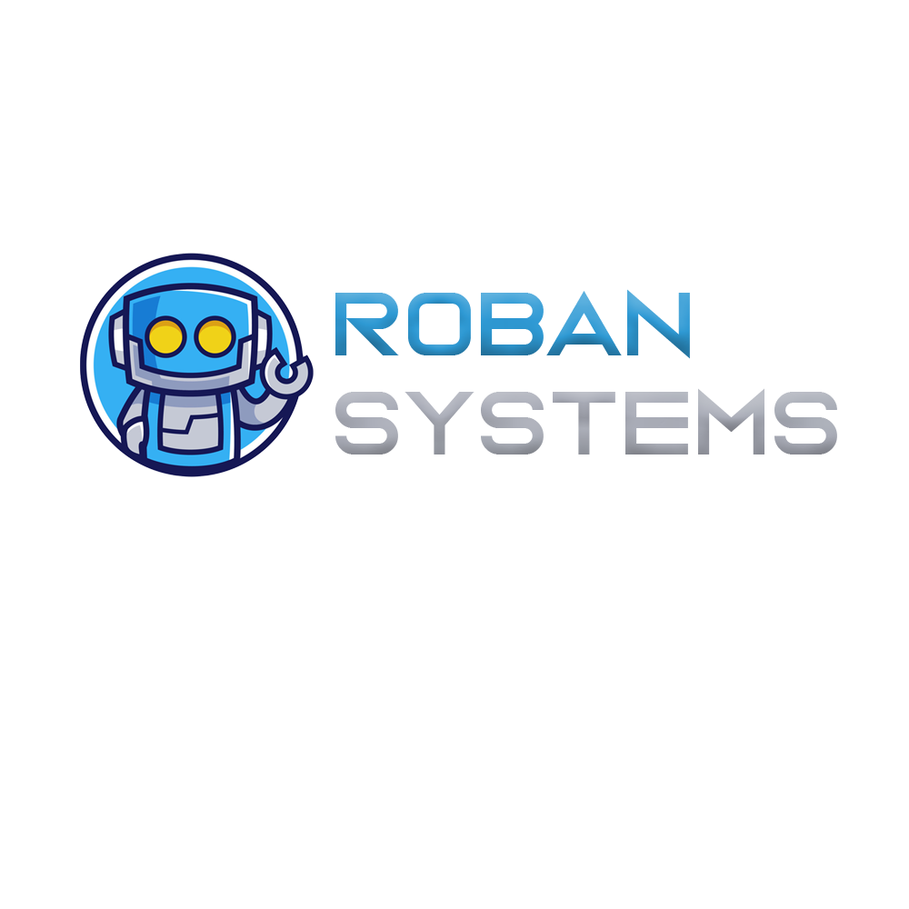
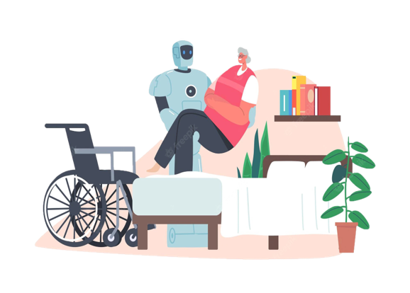
AN HELPING HAND FOR DISABLED PEOPLE

Slide 2




Our team
Ajay Das k
Fathima Irfana T P
Muhammed Fais M T
Rabeeh C
CCV19CS002
CCV19CS019
CCV19CS007
CCV19CS015
GROUP NUMBER : 6
GUIDE NAME : NASRIN JUMANA K T

Slide 3
Introduction Roban system is the way of setting up an Economic Environment to Help The Disabled people with help of modern IOT Technology. All human needs can be fulfilled using Roban System we use C++, modern IOT architecture and MQTT protocols to full fill the Roban System it is more Economical than human labour

Slide 4
2.Formulation Of Objectives
Economic
Very cheper than human labour.
A suitable companion for disabled people
Easy to maintain
Help disabled people to fullfill their Needs
Module wise architecture
Daily life applications
Large scale compactibility
Wide range of application,applicable to every physical needs
Can be connect infinite nodes and large scale application

Slide 5

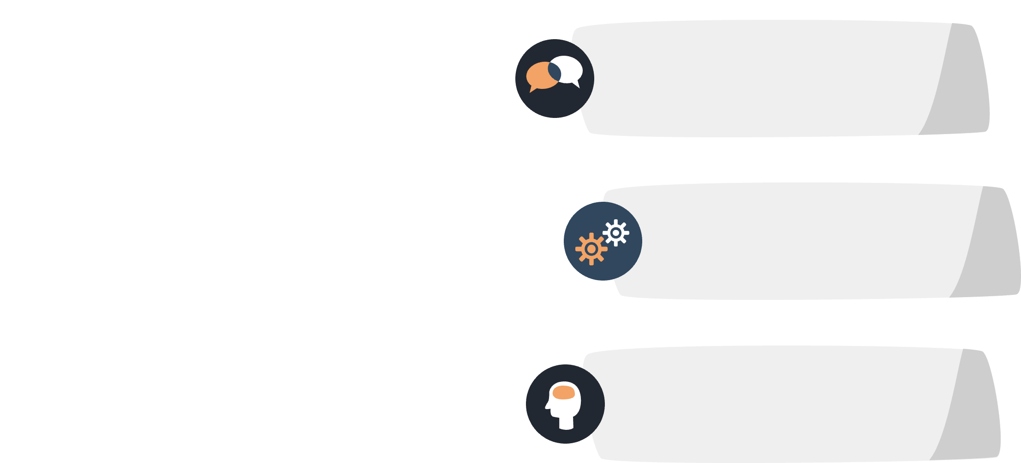
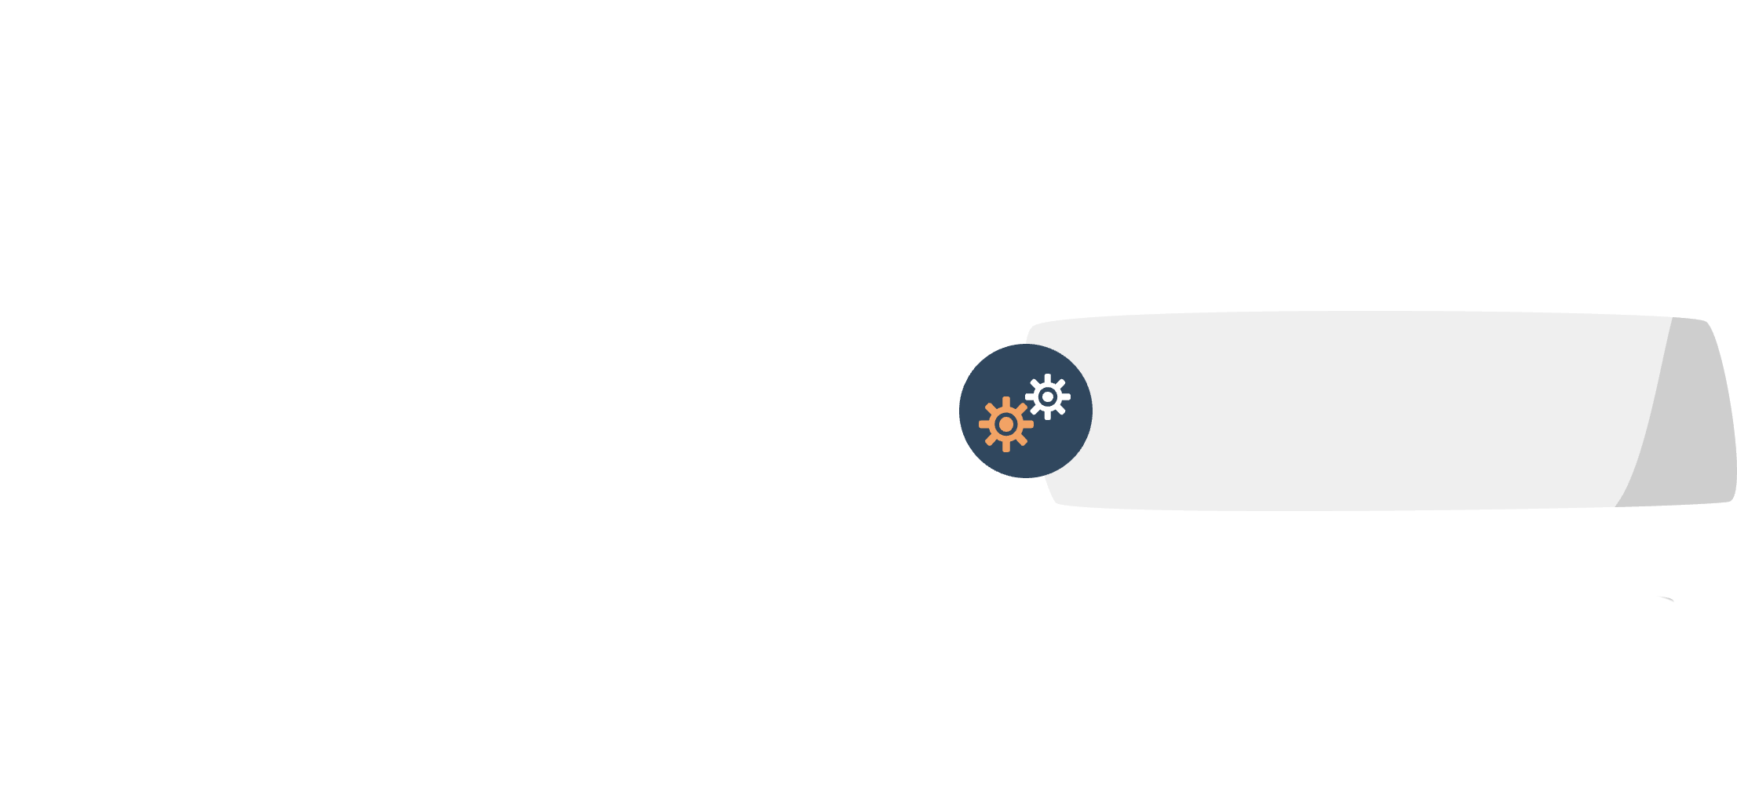
2.Project planning
Phase 1
Selecting topic,Conveying Idea,
Phase 2
First review,literature Survey
Phase 3
Making schematic,coding ,Implimentation
Phase 4
Documentation,Testing,Prototype,
Presentation

Slide 6
3.Task Identification And Allocation
Ajay Das k
Fathima Irfana T P
Muhammed Fais M T
Rabeeh C
Overall h/w
Fullfill needs
Security
Voice control
Overall connecting the modules and hardwares
Fullfilling the basic needs. Providing support to patients.
Security and surveillance to the patient and surrounding.
Controling all phyical objects using commands and guesters.

Slide 7
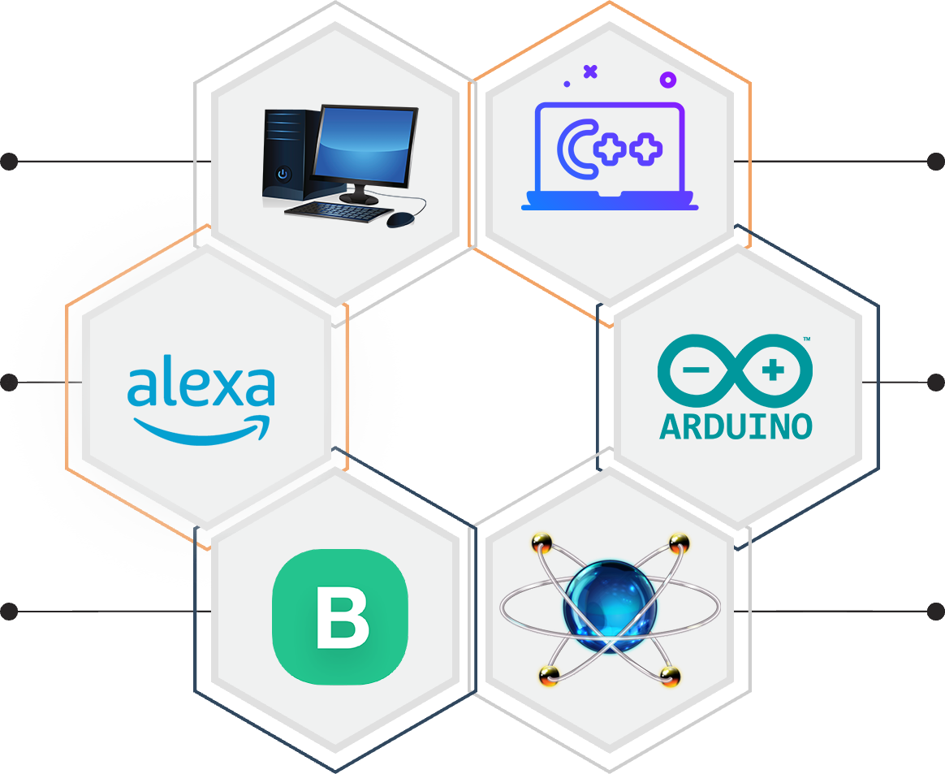
3.Requirments
Pc system
C++
Windows 7+,4 gb of Ram
C++ language is used for code
Alexa
Arduino ide
Amazon echodot speaker
To flash hende MCU and micro controllers
Blynk iot
Proteus
Blynk iot web server iot app
Circuit designing and testing

Slide 8
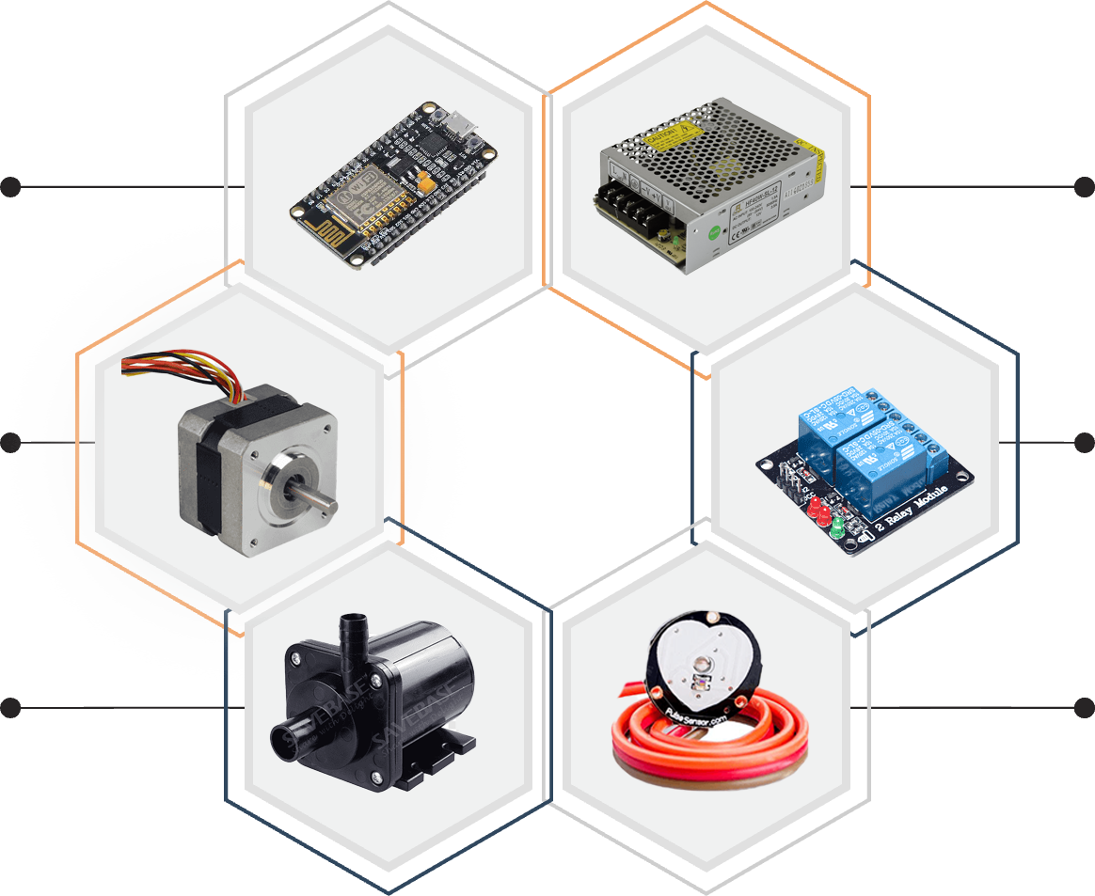
3.Requirments
Node MCU
S M P S
Micro controller bord with wifi
The power supply
Stepper motor
Relay module
Used to lift and slide things
Used to trigger current flow
Pump/valve
Sensors
To controll liquid or air flow
Used to input the data

Slide 9
4.Architecture of Internet of Things (IoT)
These Sensors or Actuators accepts data(physical/environmental parameters), processes data and emits data over network.
Sensing Layer
Collecting data and aggregating data then converting analog data of sensors to digital data etc
Network Layer
Data processing Layer
Here data is analyzed and pre-processed before sending it to data center from where data is accessed by software applications often termed as business applications where data is monitored and managed and further actions are also prepared.
Application Layer
Data centers or cloud is management stage of data where data is managed and is used by end-user applications like agriculture, health care, aerospace, farming, defense, etc.

Slide 10
Formulation of Design
Code/conditions
sensors
Micro Controller
Server
Servo,Relay,Drivers
Real world

Slide 11

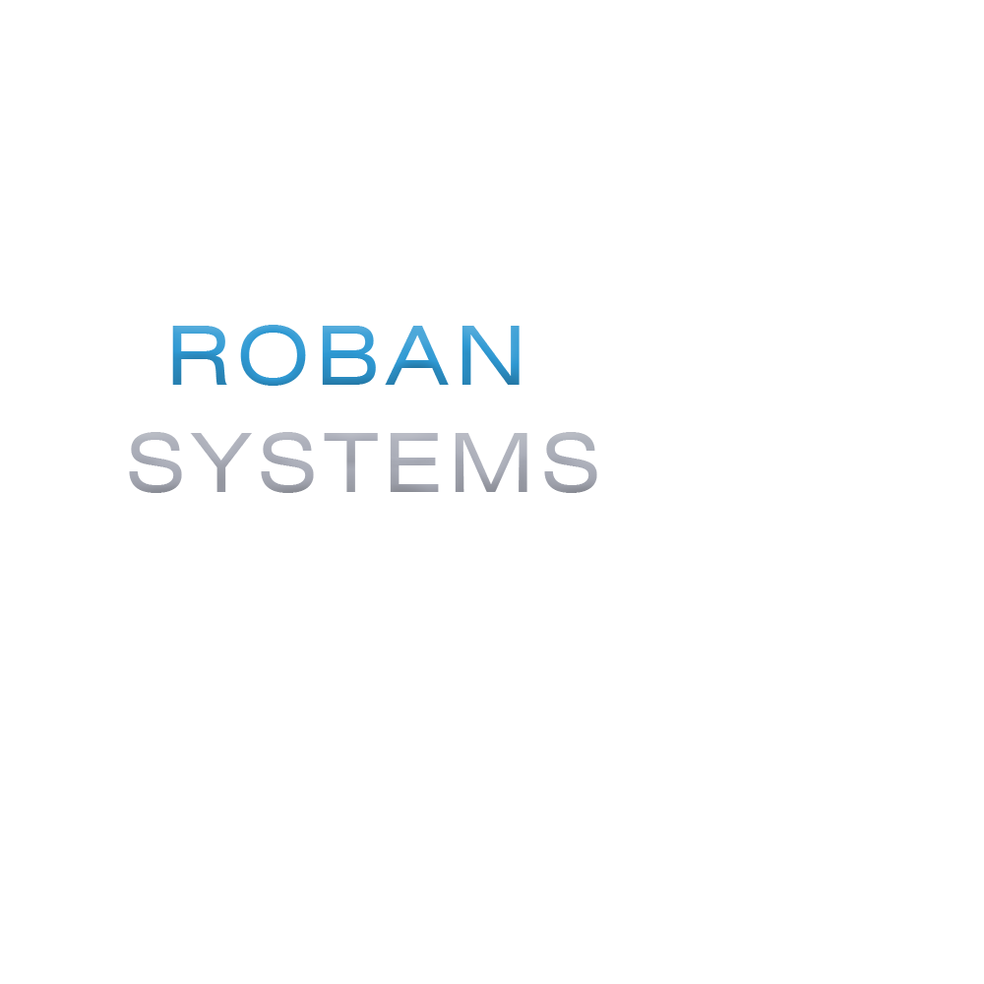
4.Modules
1
Bed
and Ventilation
4
Medical
Aid
2
Basic
Needs
5
Security and Entertainment
3
Patient Monitor

Slide 12
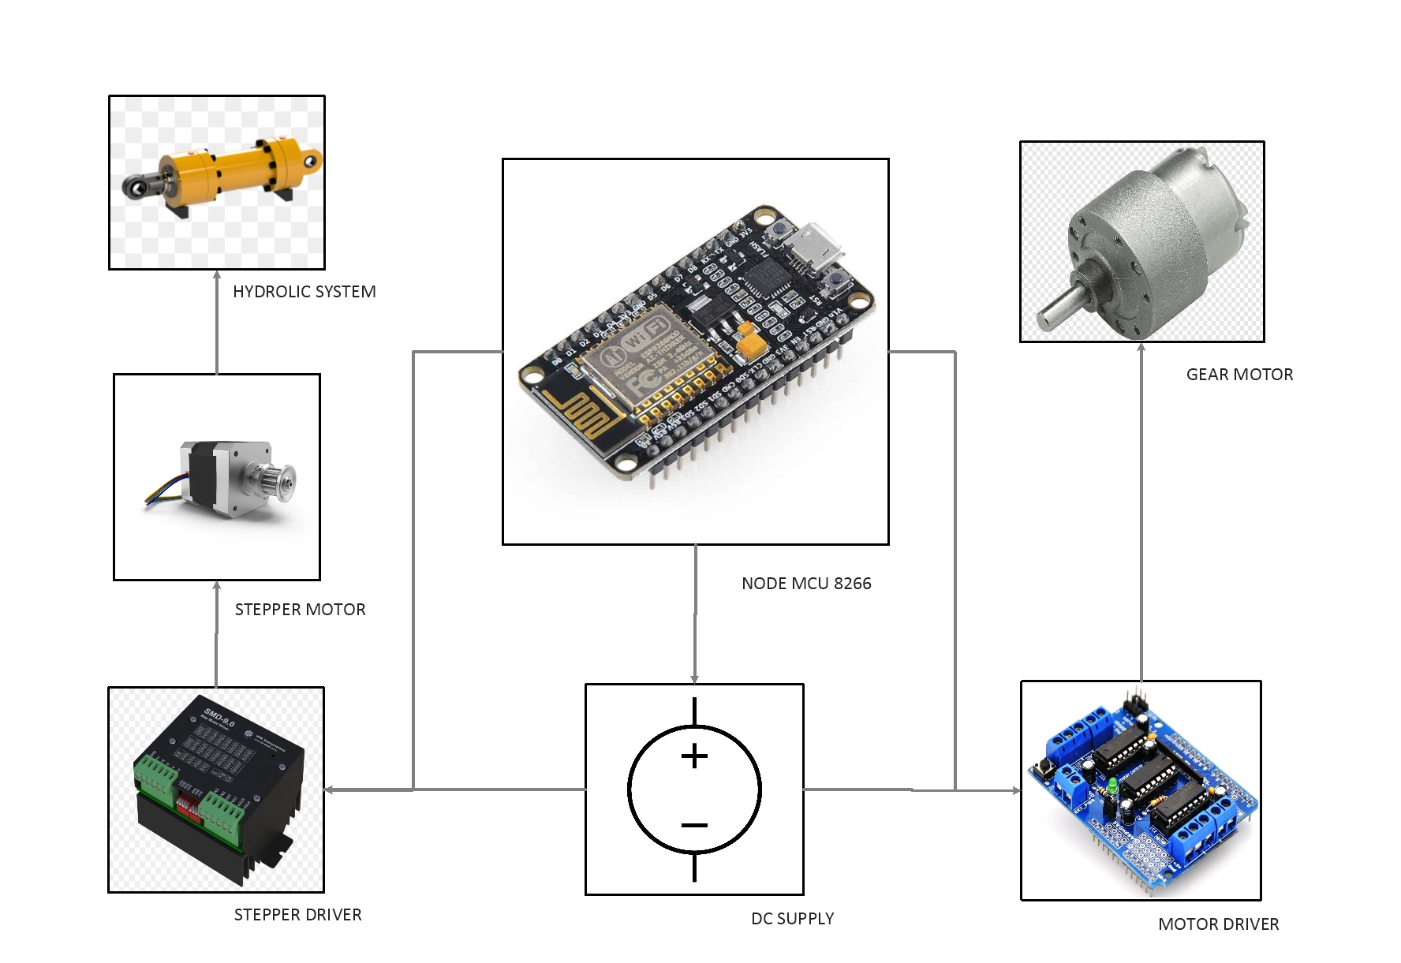
1.Bed And Ventilation Module Schematic

Slide 13
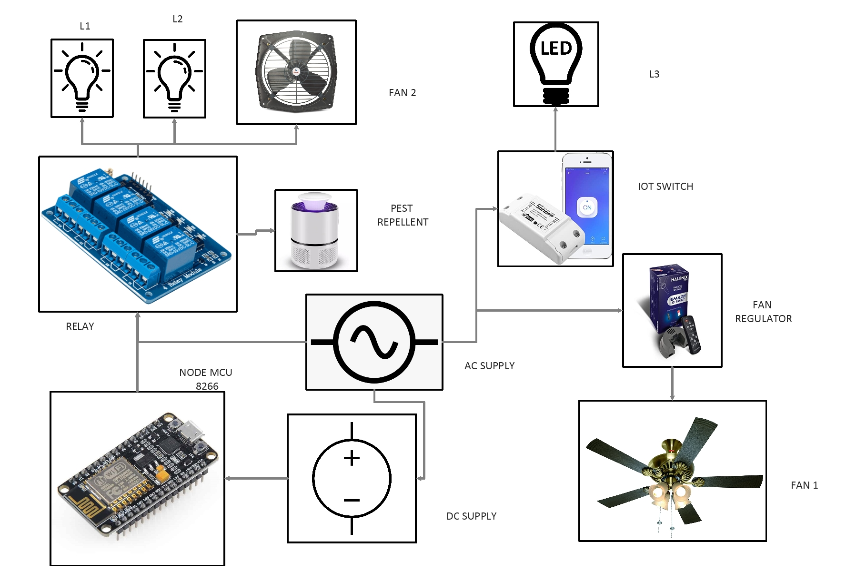
2.Basic Needs

Slide 14
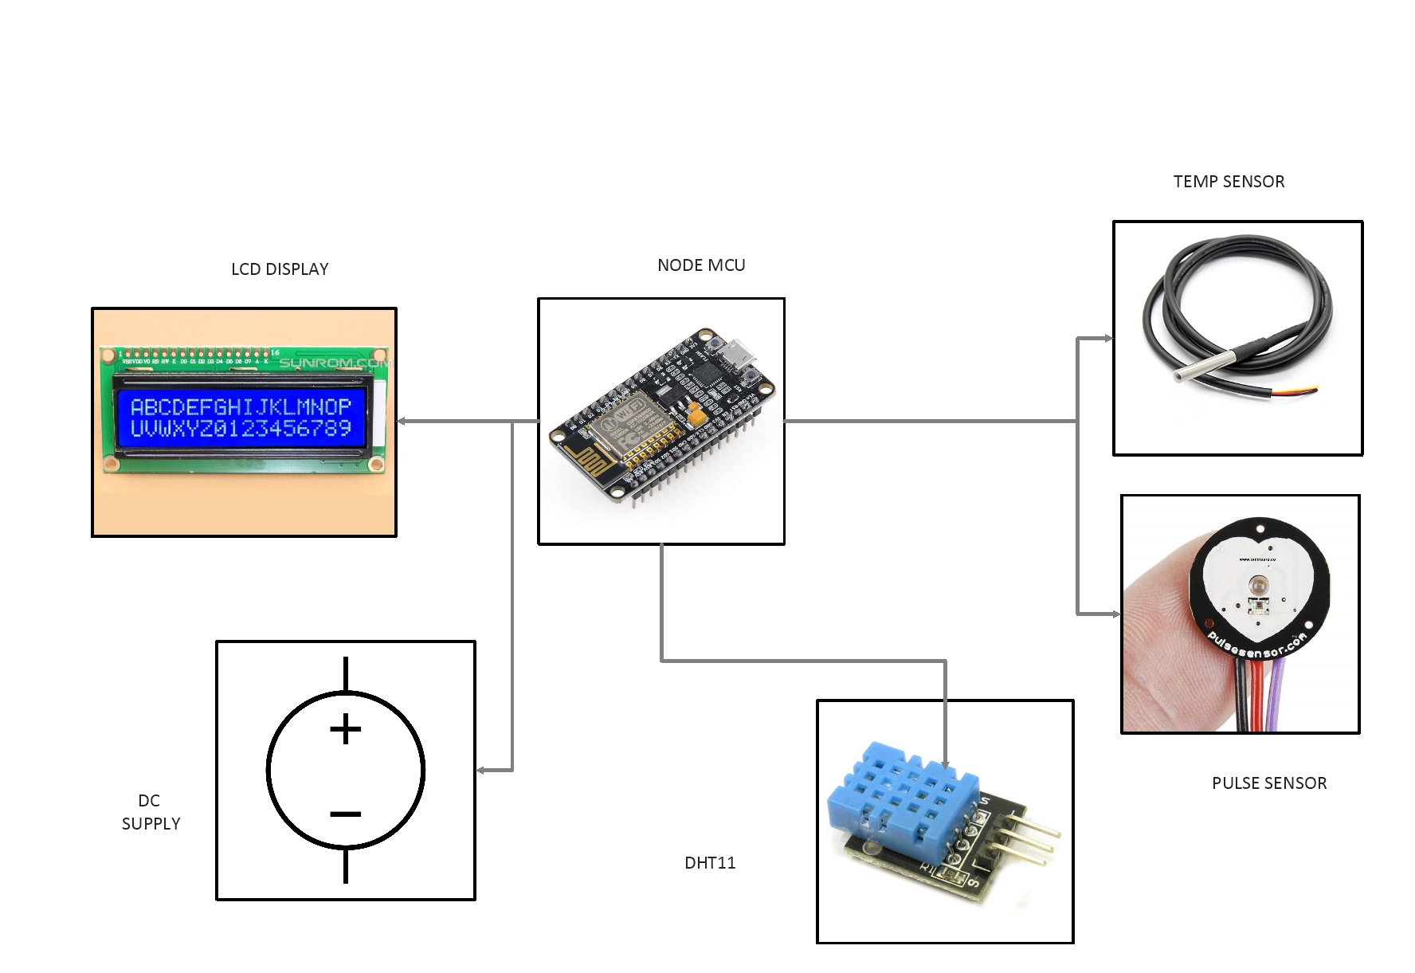
3.Patient Monitor Module

Slide 15
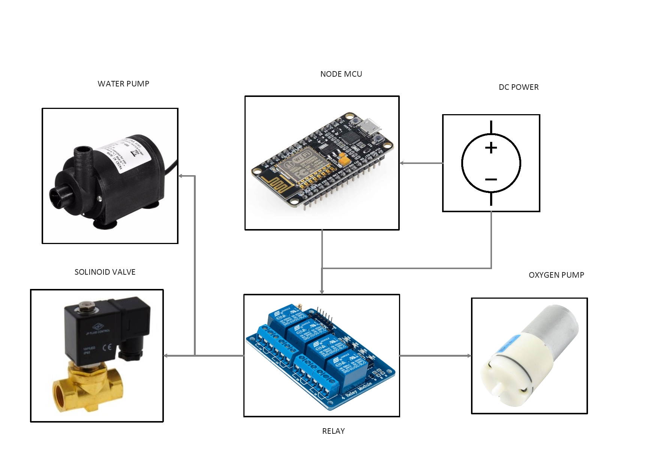
4.Medical Aid Module Schematic

Slide 16
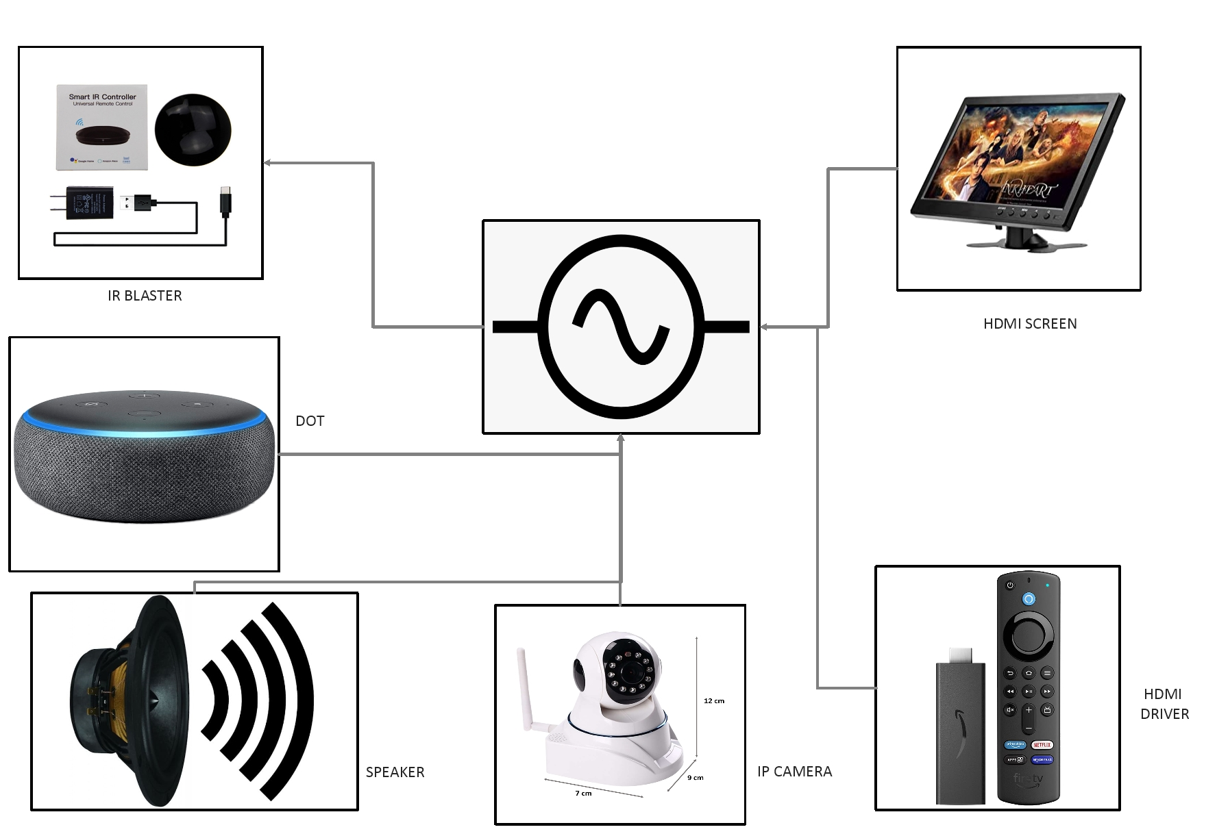
5.Security and Monitoring

Slide 17
Project progress
Completed around 90% of the project
Implemented five modules (bed and ventilation , basic needs, patient monitor module, medical aid module, security and monitoring)
Connected the modules with IOT environment
Activated voice assistance with iot devices
Caliberated sensors according to environment

Slide 18
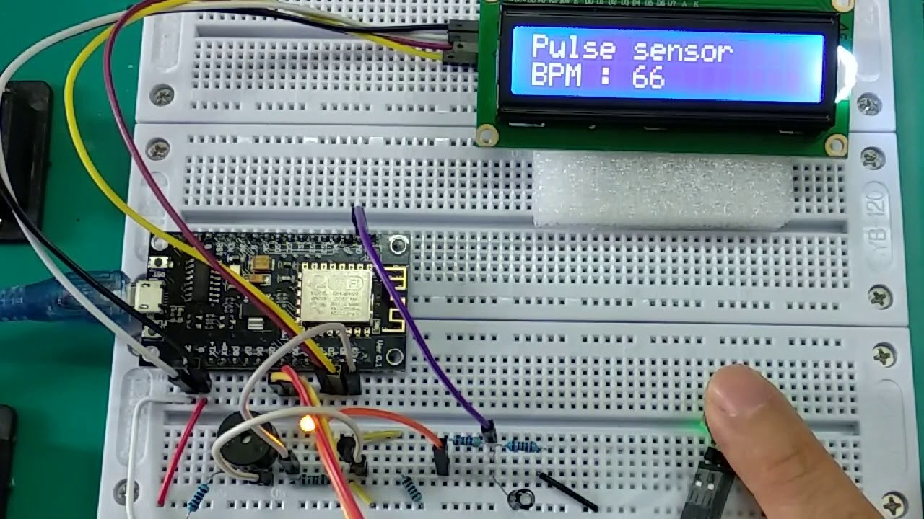
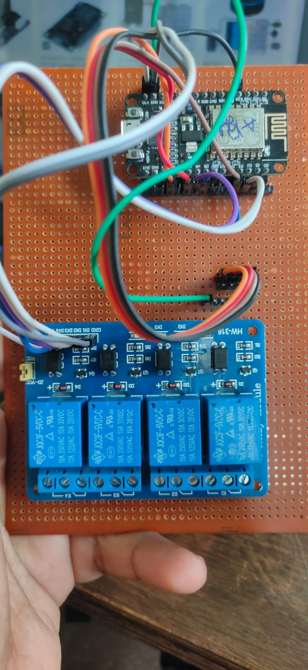
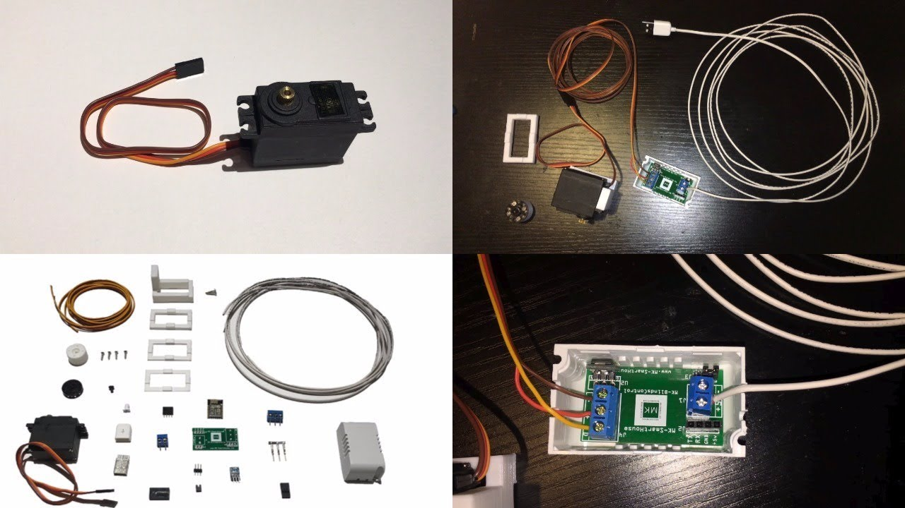
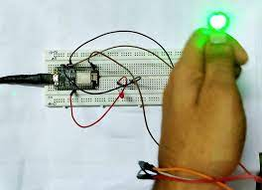

Slide 19
Reference
Git hub
Stack overflow
Knibus
Aurdino community

Slide 20
Thank you !
Any questions ?

